Slide 1
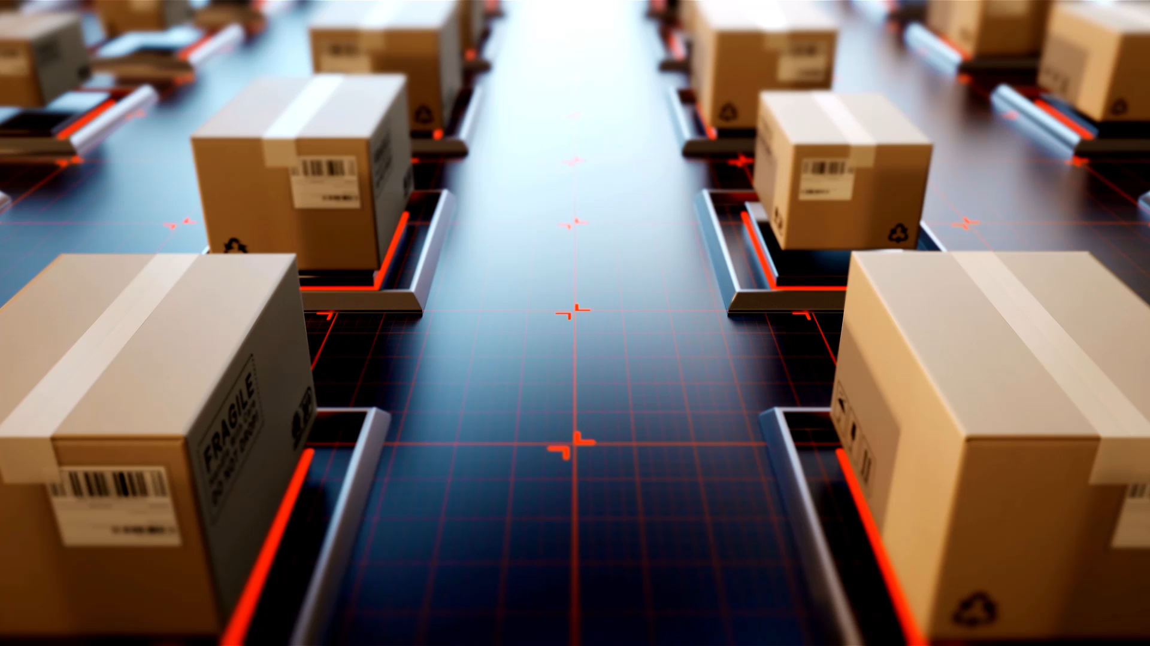
Home Depot Vehicle Routing Project
Vincent Rettke & Philip Kourmoulis
MSBA Spring 2022

Slide 2
Problem Statement
Design, construct, and use a Python application that can solve a capacitated vehicle routing problem for Home Depot Locations in Alabama, California, and Texas

Slide 3
Variables
Stores
Distribution Centers
Constraints
Store demand – Average weekly demand
Truck Capacity - 40,000 lbs
Objective function
Assign distribution centers and truck routes while minimizing total distance traveled and accounting for the constraints given
Routes

Slide 4
Additional Constraints
Distance
Our routes needed to be completed within the legal 11 hours allotted to truck drivers
Distance constraint set at 480 miles
8 hours of drive time at 60 mph
Dock Time
Industry average of 2 hours to unload a truck
Dock Time constraint set at 2 hours (120 miles)
Buffer
1 hour allotted for traffic, weather, additional dock time, etc.

Slide 5

Our Process
Tableau: K-Means Clustering
Export Data (e.g. "Alabama_Clusters.csv")
Get the "best" distribution center and route(s) for every cluster (Clarke-Wright algorithm)
Result: Optimal distribution center and set of routes with the shortest total distance for each cluster

Slide 6
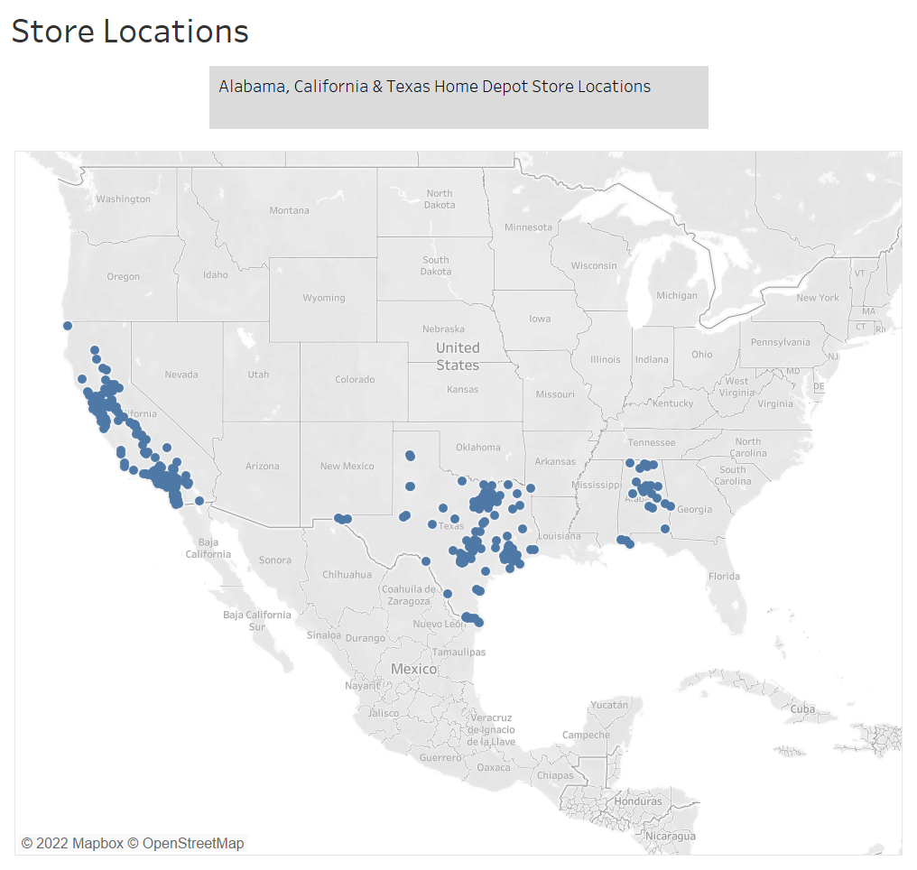

Slide 7
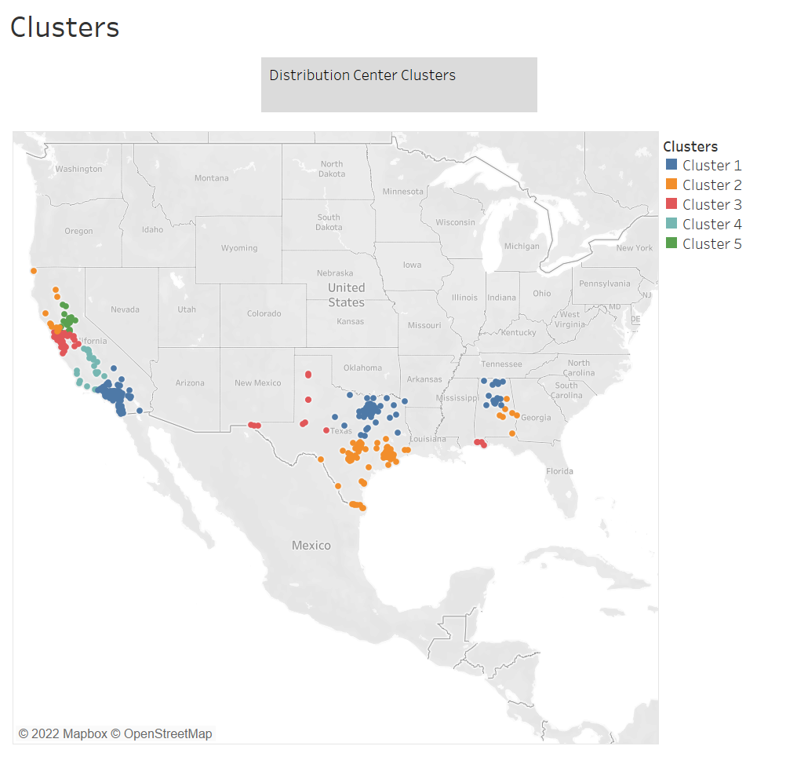

Slide 8
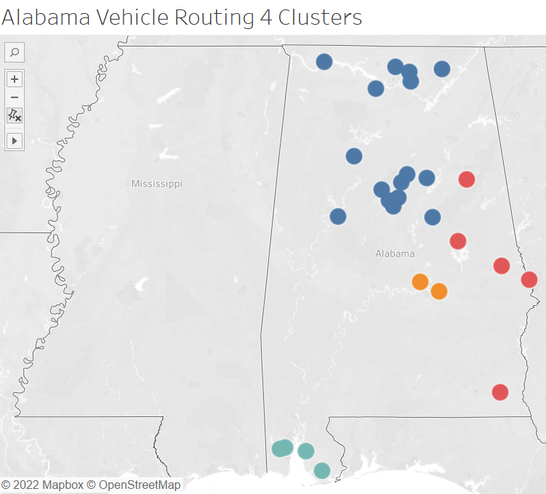
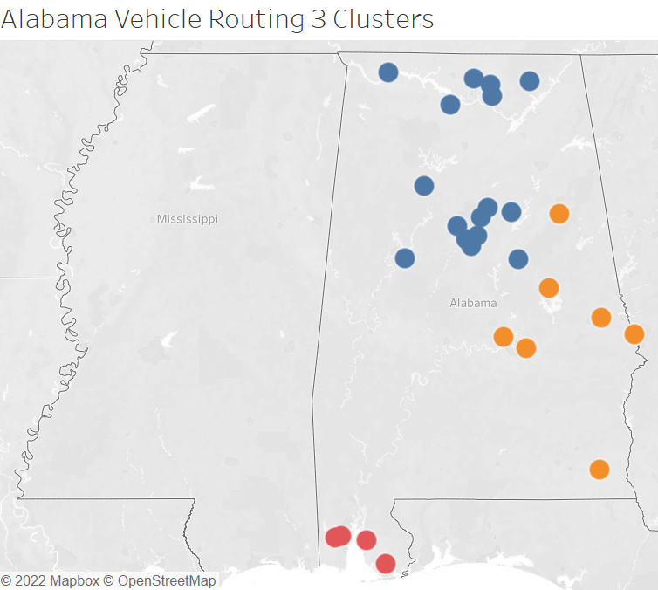
Cluster Selection

Slide 9
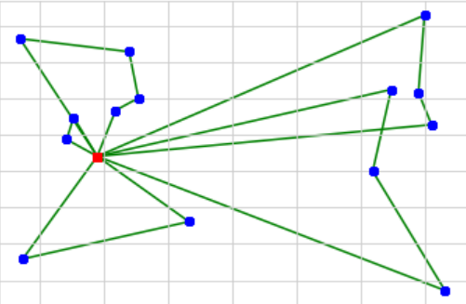
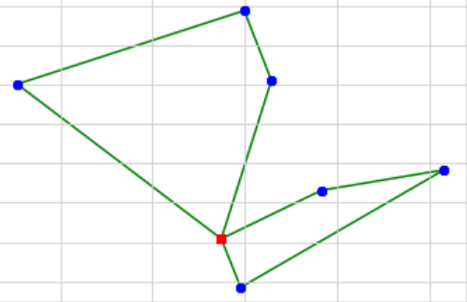
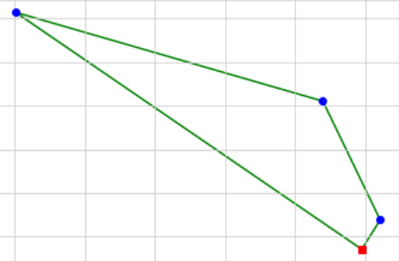
Distribution Center 1
Routes/Trucks: 5
Store 882: Fairfield
Distribution Center 2
Routes/Trucks: 2
Store 883: Montgomery
Distribution Center 3
Routes/Trucks: 1
Store 801: West-Mobile

Slide 10
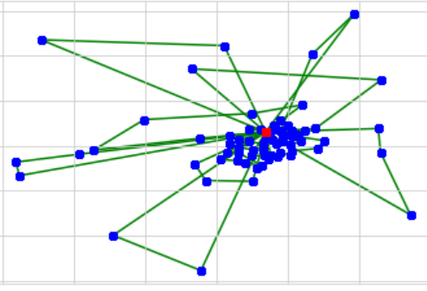
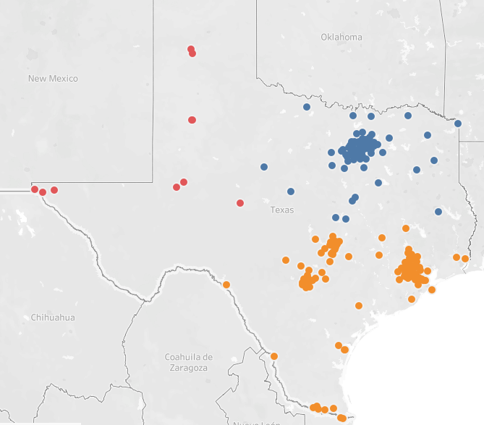
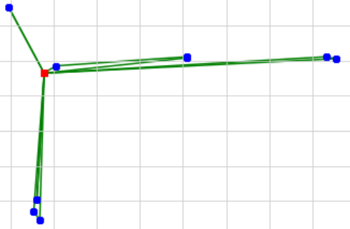
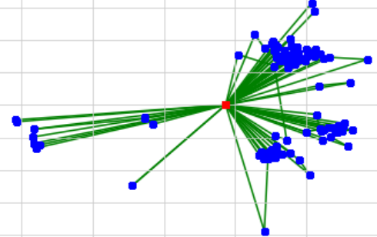
Distribution Center 1
Routes/Trucks: 17
Store 550: White-Rock
Distribution Center 3
Routes/Trucks:5
Store 562: Odessa
Distribution Center 2
Routes/Trucks: 35
Store 6587: Victoria

Slide 11
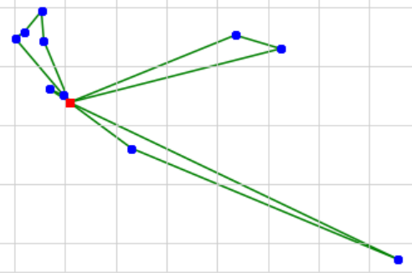
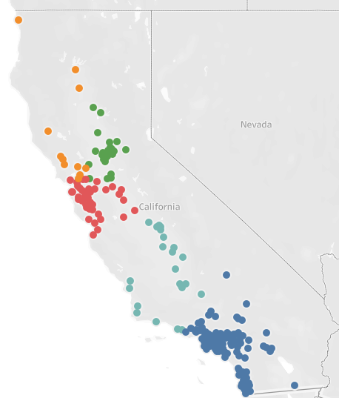
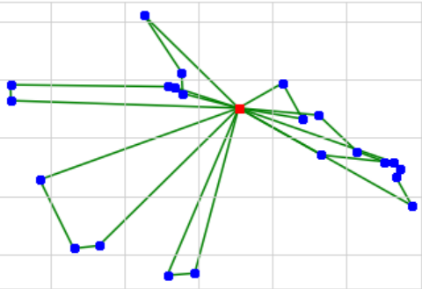
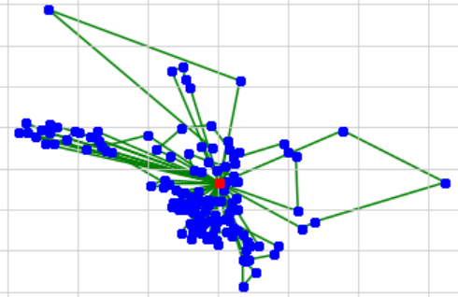
Distribution Center 2
Routes/Trucks: 3
Store 6667: Windsor-CA
Store 6636: Freemont
Distribution Center 3
Routes/Trucks: 9
Store 550: East-Irvine
Distribution Center 1
Routes/Trucks: 25

Slide 12
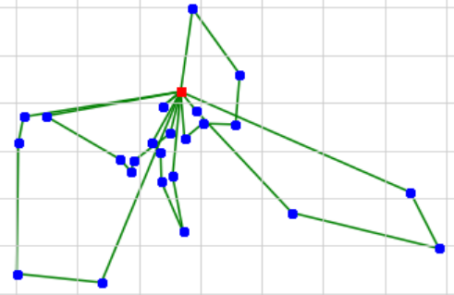
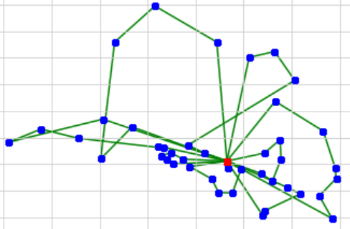
Distribution Center 5
Routes/Trucks: 6
Store 6675: Folsom
Distribution Center 4
Routes/Trucks: 7
Store 8426: Delano

Slide 13
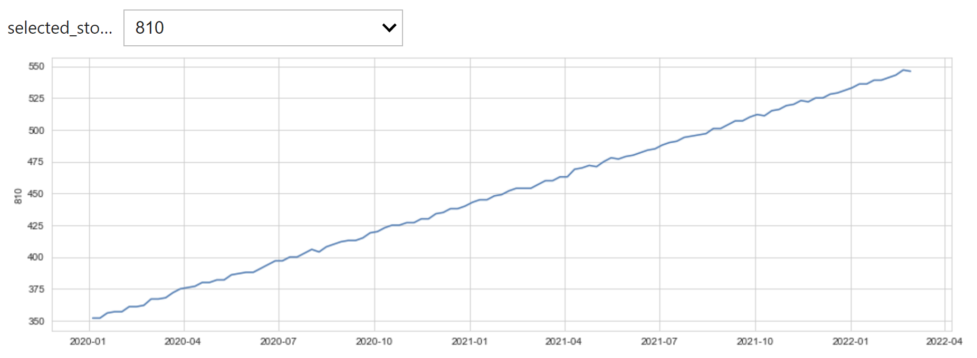
Moving Forward
Distribution Center and Truck Cost
Minimize total cost
Size of DC
Account for changing demands
Use predictive model to determine more accurate demand
Use Actual Map Routes
Use estimated times, real-time traffic analytics, bad weather, etc.
Routes can be different EVERY day

Slide 14

Questions

